Slide 1
Building an Open-Source Performance Testing Framework in the Cloud
Gopal Brugalette
Notes:
Agenda - presentaion about enterprise, and then hands on.
concur, Nordstrom, WaMu, IBM

Slide 2
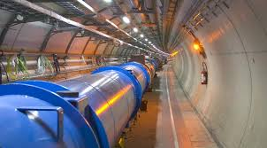


Gopal Brugalette Principal Engineer, Performance
Notes:
Also PM, Scrummaster, Program Manager

Slide 3
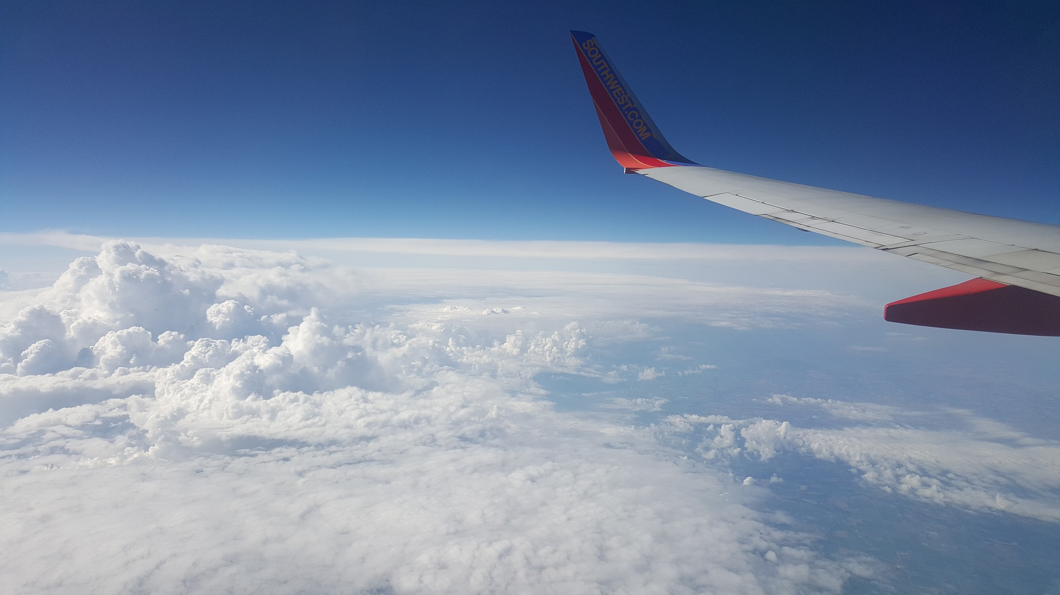
Introduction – so you want to build a framework
Building the Framework
Requirements
Management
Design
Build
Powered by AWS
Notes:
Why, how, the what
Reality is it isn’t the engineering that’s hard…

Slide 4

Why build a framework?
Cost
Capabilities
Control
Challenge
Powered by AWS
Notes:
There are a lot of compelling reasons to build an opensource framework, you can certiainly buy one
– some of the popular reasons opensource – story about xwing? Daddy I made it better (picture of here at birthday)
Cost – maybe you think it’s cheaper to do opensource
Capabilities – make it do everything you want it to do? Commercial tools might lack a certain feature you need/want
Control – fits in with your vision and roadmap & Compatibility/integration – combine this into your – works with your other stuff and how you/your company works/ your environment
Challenge – (brain) you have to do something to justify your existence, engineering excellence

Slide 5

The stakeholders
Who
What
Why
When
Powered by AWS
Notes:
think about this as a product- your audience/customers/users,enterprise standards, company culture,
developersWho is going to be developing this?
One dev team for their own use or one sdet or an enterprise team that is going to be used for agile teams
-what’s your usage model – strict governance or loose, with interchangeable pieces – tight coupling or loose coupling
What’s your timeline and deliverables – you’ve got to do it fast- do it agile – internal opensource or tight control

Slide 6
What will it do
CI Pipeline Integration
Spike
Load and Performance
Endurance or Soak
Stress
Production Full-Scale
Powered by AWS
Notes:
Ci – noone looks at results, endurance – you might want real time analysis

Slide 7

Who are your users
Devs
SDETS
Perf Engineers
Automation
Powered by AWS
Notes:
Primary stakeholders are the users
And who are the users and what do they care about?
Devs – easy to click test, get some result – check I did it, DOD
SDETS – easy to click test, get results, control what is tested maybe?
Perf Engineers – control the test and analyze the results – a lot of different tests
Automation
-api’s (restful)

Slide 8

Who will build it
Background
Skills
Why
Team Dynamics
Powered by AWS
Notes:
What skills do you need? Do you need evelopers, domain knowledge
Cloud experience?
Your team
-challenge, ownership, learning
Developers
SDET’s
Performance ENgineers
Operatons
Role
Background
Skills
Interests
How long are they going to be around – just one project, or sustaining

Slide 9

Leadership
Enterprise Direction
Success Measurements
Value
Budget
Powered by AWS
Notes:
Vision, what problems are they trying to solve –
JJ - scriptign is the big problem
or too many head count - reduce the analyis -
a lot of companies are moving toward devops/ agile / fullstack teams, and maybe you’re having conversations about where does the responsibilities for quality lie – this is a way to get performance expertise into an agile team, or a devops team or a fullstack team. AT concur, at Nordstrom, a lot of places… do they want this to fit into their vision what do you need to get funding?
Value – scripting/analysis/hardware costs/infrastucturer management time/cost
What do they want to see? What are they concerned about, what are the metrics they are going to measure, what are they trying to solve
Leadership

Slide 10

Manage the Effort
Find the Time
Project Methodology
Sustain
Powered by AWS
Notes:
How are you going to get all this work done?
full-time, part time, free time? What else is the team doing? – PEF-a-Thon
if you keep supporting al lthe other work, when are you going to this, it’s never urgent comapred with ateam that is going to launch in a month and needs perf now!
Project, standups – methodology scrum, kanban, etc., jira, whiteboard, stickies, trello
Preogress reports, take in feature requests, etc... Is this a one time effort, or an ongoing service – cause de existence?
Am I an engineer or a project manager

Slide 11
Components of the framework
Test Artifacts
Scripting
& Exec
Load
Generation
AUT
APIs
UI
Orchestration
Metrics
Reporting
Analytics
Notes:
Conceptual Framework
In actual implenetation, might be integrated
Person or pipelines
Overall architecture – are there company standards – AWS/on prem, etc.?
Script repository
API’s
Scripting/exeuction
Tool
swagger
Load generation architecture
Pipeline Orchestration
Results Data Store
Analytics
Reporting/Visualization/Alerting
Training, supporting, selling

Slide 12
Designing the framework
Hand it off
Re-usable
Structured inputs and outputs
Modularity
More than sum of parts
Powered by AWS

Slide 13

Deliver Value and Iterate
R1
Basic load and graphs
R2
Dynamic load
R3
Alerting
R4
Auto-scripting
Pipeline integration
Deeper analytics
Reporting
More alerting
Powered by AWS
Notes:
Agile- iterate and learn fast
This is a big challenge – too little too fast or too little too late
So we looked at all the components and value that the fraeowkr can bring, but how are you going to actually deliver that?
We hada challenge of heavy technical requirements and value I wanted to go for value first, technical afterward
Iterate – dleive value and do it fast, then improve – doesn’t have to be perfect the first time.
At nord our initial MVP was too big, both in vision and technical regulations
We needed to be in the cloud, have API’s, immutable architecture, 10 factor app, be opnesource, switch orchestrations, etc.

Slide 14

Development Principles
Design
Architecture
Containers
Cloud, on-Prem
Tool Selection
Integration
Capabilities
Community Support
12 factor app
Powered by AWS
Notes:
How does it fit with your vision
Plugins – puppet, chef, etc..
Languages, technologies/ stacks
Integation & interoperability with your framework & architecture
Your Knowledge, Experience
Docker/kubernetes

Slide 15
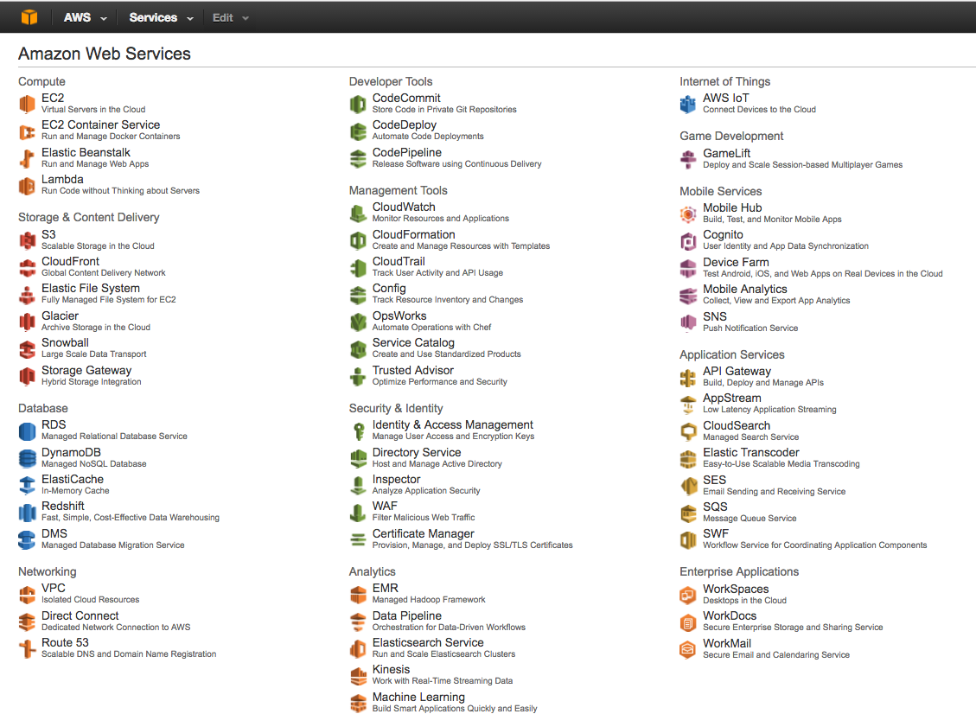
Powered by AWS
Notes:
Cloud first – no training – where to start?

Slide 16
Working in AWS
Concepts
Automate It!
SLA’s
Cost & Capacity
AWS Services
EC2, Lambda
Dynamo, S3
Kinesis, SQS
Cloudwatch, Elastic Search
Networking & Security
ELB
VPC
Security Groups
IAM Roles
Powered by AWS
Notes:
It’s a whole new world – not just a data center
Automate Everything
-it could be gone in a second – pets vs herds/cattle
USE AWS offereings– don’t waste your time... API gateway, where do you want your time
Pep and ES – need t ogo faster & spend your time where its valuable
Ami’s are the simplest, but you eventually need an AMI factory…
Which brings you to puppet & chef, cloud formation
r
– you pay for the box, whether you need it or not
Start small and add capacity

Slide 17
Scripting & Execution Engine
Tool Consideration
Jmeter,Gatling,Artillery...
Scripting
Applications under Test
Language & capabilities
Code based or UI
Integration
Automation support
Results Output
AWS Load Generation
Powered by AWS

Slide 18
Load generation
Resources
dynamic or static
EC2
Lambda
On-prem
Capacity and Spin Up
Cost
Management Effort
Test Types
Considerations
Network Access
Powered by AWS

Slide 19

API’s
Hide Details
Integrate
Standardize
Expand Tool Features
Extensible
Lambda in AWS
Powered by AWS
Notes:
Nobody needs to know if you’re using jmeter, or ES
Standardize the interface and usage – use multiple tools
Integrate with other parts of the archtecticure or make it easier to reuse
Extend to Chatbots or Amazon Elexa
Great option for Lambda

Slide 20
Orchestration
Test Assets
Spin up
Run Test
Analyze Results
Report
Spin down
Workflow/Pipeline Tools
Jenkins
Go
Rundeck
API’s
Lambda - SMS, DynamoDB
Server-based logic
Custom Scripting & Logic
Gateway
Powered by AWS

Slide 21

Data Store
Data Collection
Agent/forwarders
Log Stash/Beats
Telegraf
Direct writes
Streaming
Extracting Data
API
Query Language
Application & Server Metrics
CloudWatch
APM
Logs and Plugins
APM Tools
Splunk
Influx
Elastic search
Options
Dynatrace
API's
Post
topbeats
Size & Capacity Limits
Raw or Analyzed
Visualization Support
Powered by AWS
Notes:
We built our own Elastic Search – and honestly - wasted a lot of time.
Kinesis

Slide 22
Analytics
Performance Data
Response Time
Errors
Throughput
Information
Trending
SLA, Pass/Fail
Anomalies
Distribution
Application & Server
Stack traces
Resource Utilization
Processing Time
Implementation
Custom
R
Python
Plug-Ins & Packages
Watcher, Elastalert
TimeLion
Built-in
Time Series
APM
ELK, InfluxDB, Cloudwatch
Dynatrace
Scala
Julia
R, Python Packages
Kapacitor
Powered by AWS
Notes:
Elasta alert – python by Yelp
Watcher
R and Python can be plugged in

Slide 23

Reporting
Visualization
ES/Kibana
Grafana
Tableau
APM tools
CI Integration
Pass/fail
Stop the build
Alerts
Email
Pager
Shiny
Slack
Chronograf
Watcher
Elastalert
Kapacitor
Powered by AWS
Notes:
Information & Action
Analytics Visualization
Dashboards, Summary Reports

Slide 24

Testing the framework
Scaling
Resiliency
Pilot teams
Analytics
Alerting & Reporting
Powered by AWS
Notes:
It’s surprisingly easy to adopt a mentality of I don’t need to test – what can go wrong? Even for a tester
Pilot teams
Resilienicy – what of things fail, what if AWS fails? Can you know, can you handle it?
Also become your advocates
What of the site is down?
TDoes your framework even scsale?
Testing your analysis – generate test data with R is easy

Slide 25

Encourage Adoption
Culture of Reuse?
Who has Responsibility?
Market It
Train Them
Powered by AWS
Notes:
So you’ve built it, this great thing, will anyone use it?
Does your culture support re-use?
Marketing plan
Target teams that need it and will use it
Push/pull
Maybe you’re a big company like SAP – all over the world
Do you need to sell it before you even build it? Do you need funding?
Are they mutivated to do perf, use your tools, can you support them?

Slide 26

Training
Videos
Wiki
Lunch & Learn
1-1
Office Hours
Powered by AWS

Slide 27
Support your framework
Process
SLA’s
Email
Slack, IM
Office-hours
Wiki
Ticketing System
Communication
Pager support
Follow the sun
Powered by AWS

Slide 28
Example Frameworks
Test Artifacts
Scripting
& Exec
Load
Generation
AUT
APIs
UI
Orchestration
Metrics
Reporting
Analytics
Notes:
PEF v1 – scale issues
PEF v2 -
PEF v3 – API’s
Artillery on Lambda
Jmeter on Lambda
Gatling/Jmeter on Prem across multiple data centers
Gatling/Jmeter mix hybrid

Slide 29
A Simple Framework
Git
Jenkins
Jmeter
Jmeter
Jenkins
Static Servers
Notes:
Maybe in the cloud, maybe not – first one wasn’t
APM tools like Dynatrace, New Relic

Slide 30
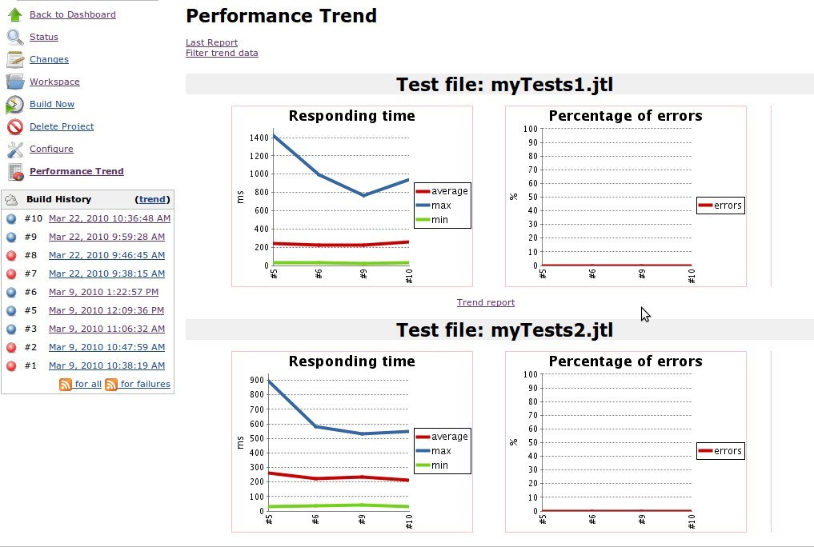
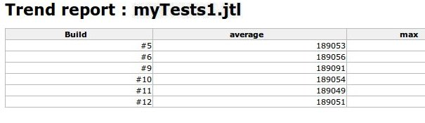
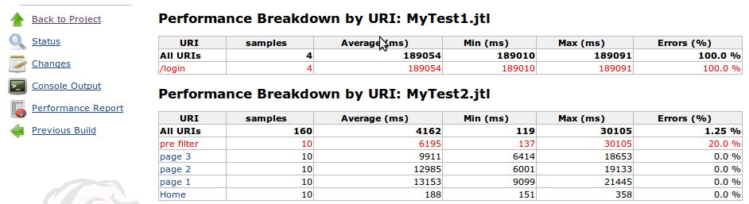
Analytics and Reporting
Jenkins Performance Plugin
Notes:
Static Servers, limited test size, # and analytics – no real time, but a lot
https://wiki.jenkins-ci.org/display/JENKINS/Performance+Plugin
This plugin allows you to capture reports from JMeter and JUnit . Jenkins will generate graphic charts with the trend report of performance and robustness. It includes the feature of setting the final build status as good, unstable or failed, based on the reported error percentage. Report formats supported:
JMeter XML format (CSV is currently not supported, see JENKINS-16627)
JUnit format (used by Soapui for example)

Slide 31
A Basic Framework
Git
Logstash/Beats
Jenkins
ES
Jmeter
Jmeter
Jenkins
Kibana
Static EC2 Servers
Notes:
With ES and Kibana, realtime, plus more complicated exploratory analytics

Slide 32
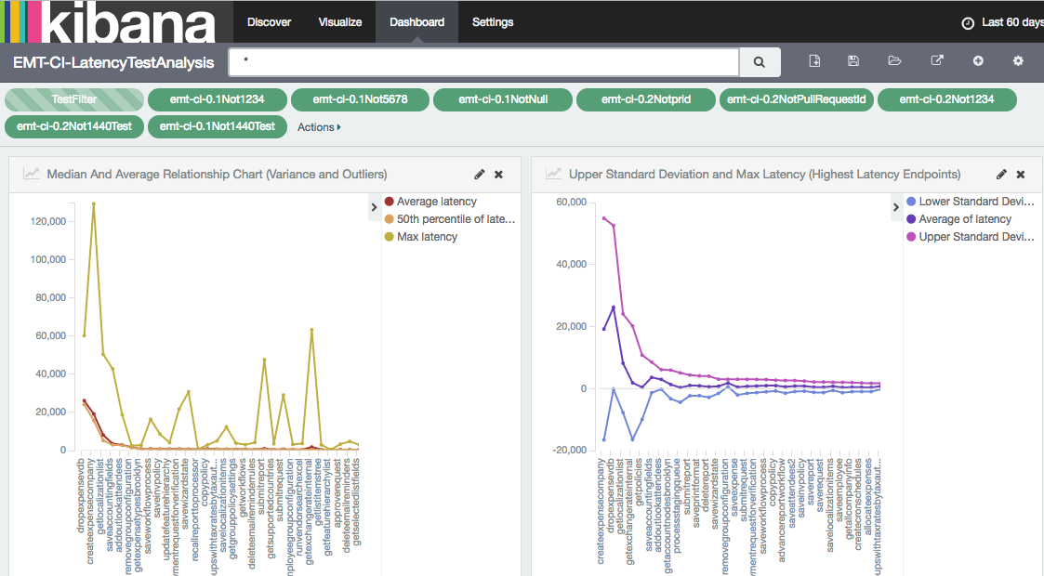
Analytics and Reporting
Powered by AWS
Notes:
elastalert

Slide 33
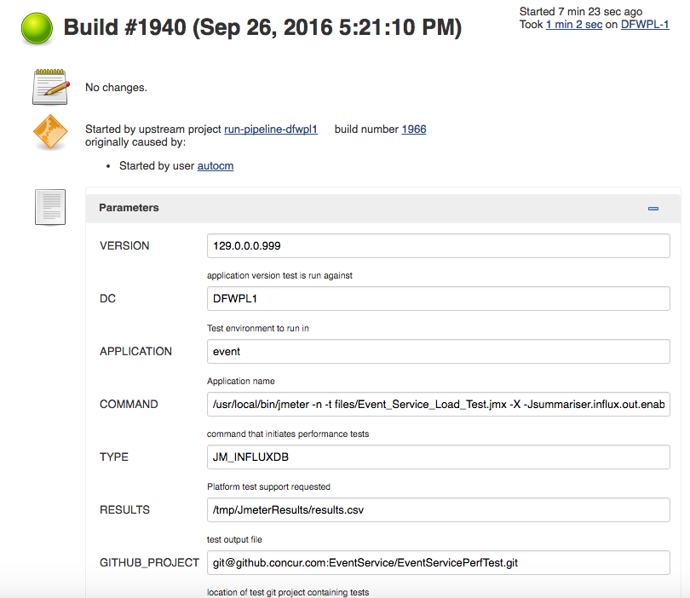
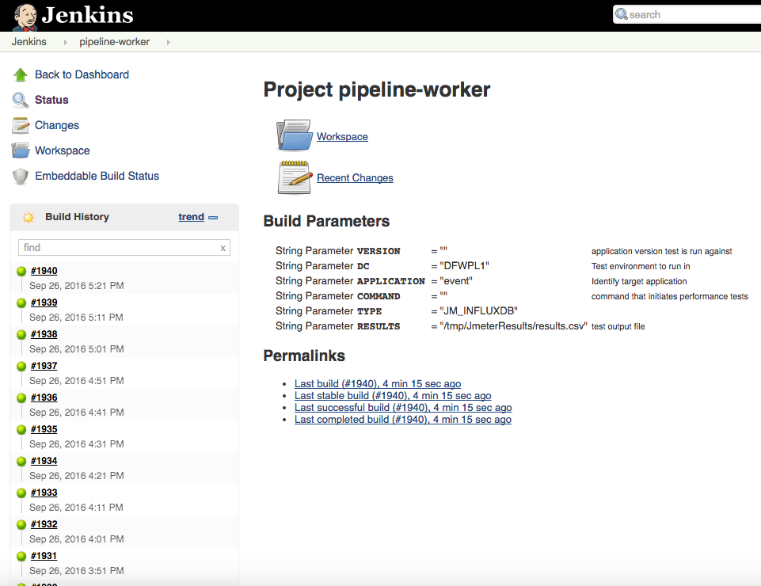
Jenkins, Jmeter to Influx
Powered by AWS

Slide 34
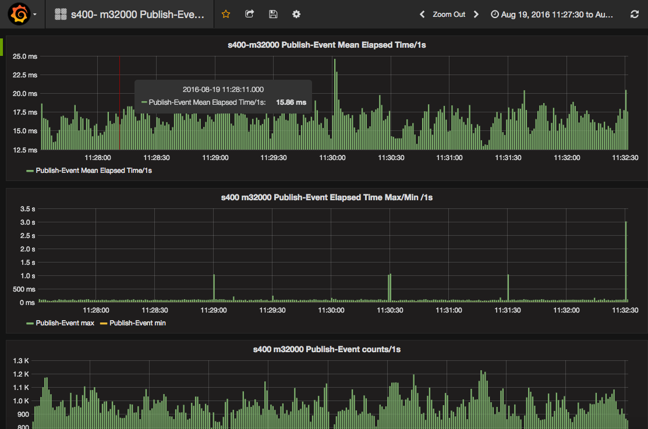
Influx/Grafana Dashboard
Powered by AWS

Slide 35
Dynamic Scaling
Dynamic Jmeter Machines
Jenkins
ES
Jmeter
Dynamic Creation
Jmeter
Kibana
Logic
Jenkins
Spin Up Machines
Distribute Scripts, Data
Notes:
Script splits the jmx file and the data files – uniformly, Jmeter results integration happens through ES, all AWS work done through – API’s
scaleable

Slide 36
Dynamic Scaling II
Kinesis
λ
ES
S3
Call λ
λ
λ
or
λ
λ
Logic
λ
Jenkins
λ
λ
λ
Distribute Scripts, Data
Jmeter,Gatling,Artillery (Java)
Notes:
Kinesis or write to S3

Slide 37
API’s
API’s
λ
λ
λ
ES
API
GW
λ
λ
λ
λ
λ
λ
λ
λ
λ
λ
Kibana
λ
λ
API’s
Gatling
Jmeter
Notes:
API’s maybe even write the scripts – for easy endpoints
Maybe you use jenkins, maybe you don’t

Slide 38
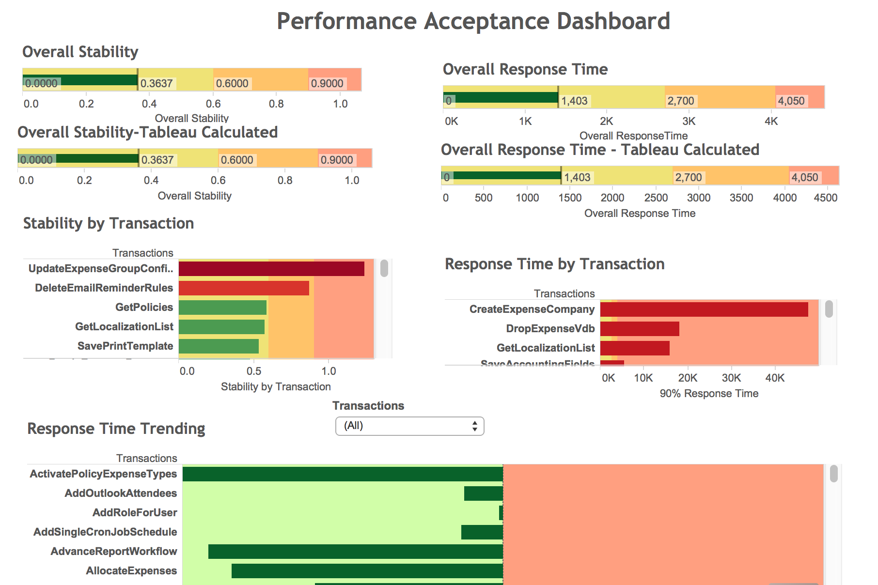
Custom Analytics
Tableau
R
ES
Jenkins
Powered by AWS

Slide 39
Hands On Training
Spin up AWS Resources
Install Elastic Search
Install Kibana
Install Jmeter
Install Logstash
Write jmeter script
Create Kibana Dashboards
Monitor Test in Kibana and Dynatrace
Let’s do it!

Slide 40
Linux Basics
ssh – secure command line terminal
scp – secure copy a file to a remote system
ls – directory listing
cd – change directory
sudo – execute a command as root
chmod – change permissions on a file
mv, cp – move, copy file

Slide 41
Linux Basics
vi – file editor
i – switch to insert mode
x - delete character
D – delete rest of line
<esc> - exit mode
:wq - write file & quit
cat – print out file
Head, tail – print out 1st,last 10 lines of a file

Slide 42
If you get lost…

